Slide 1
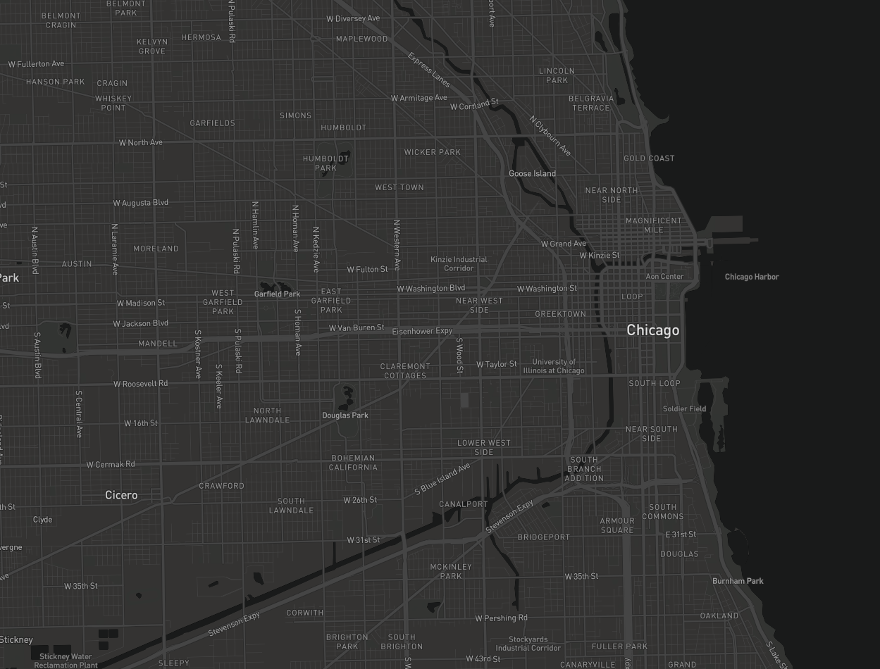
MA CSS Research Topic Benjamin Rothschild

Slide 2
Research Question
How accurate can I create a model to predict locations
of crimes in Chicago?

Slide 3
Why?
A model like this could help with resource allocation with police department or with community investment initiatives
Analysis like this can lead to further questions about what environments lead to crime
By seeing how the model improves or not when data sources are added I can hypothesize about what other datasets would be helpful in improving my model

Slide 4
Background - Academia
In Los Angeles a model was 1.4 - 2.2 times better at predicting crime compared to a dedicated crime analyst and with this improved performance 7.4% of crime was reduced in a controlled experiment that used a model to predict hotspots.
Recent social science research has taken advantage of ”Big Data” sources to achieve more accurate predictions and measurements of real-life phenomena.
Google Street View images were successfully used to measure income in New York City and Boston
Yelp data was used to help determine food inspection hotspots in New York City
Notes:
1. Focused on burglary-theft & car theft (55% of crime in LA)

Slide 5
Background - Government
Open Data Movement has resulted in:
Government datasets posted online
Brings greater transparency to governments
Allows researchers and industry to use the data for new areas of research or profit
City of Chicago is actually good at this with some datasets even updated daily

Slide 6
Background – Industry
CivicScape: “CivicScape combines data and community import to effectively deploy law enforcement.”
https://www.civicscape.com/
PredPol
They use three data points, crime type, crime location, and crime date to provide agencies with custom crime predictions, usually pinpointing areas within a 500 foot by 500 foot box
http://www.predpol.com/
Notes:
1. Focused on burglary-theft & car theft (55% of crime in LA)

Slide 7
Datasets
Plenar.io
311 Service Requests
Business Licenses
Environmental Inspections
311 Vacant Buildings
Crimes
Food Inspections
Red Light Tickets
Divvy Trips
Building Violations
Zillow/Craigslist
Rental Price Data
Twitter
Geo-located tweets
Shapefiles
US Congressional Districts
Census Blocks
Zip Codes
Neighborhoods
Tax Increment Financing Districts
Police Beats
Ward Precincts
Community Areas

Slide 8

Methods
Spatial Regression
PySAL Python Library
Data will be saved in a PostgreSQL database on AWS RDS with postGIS library for point-in-polygon operations
Mapping for paper will be done with MapBox

Slide 9
Evaluation Methods
I expect the output of my model to give a score for specific areas (blocks/radius/census tracts, etc) and I will try to correlate these scores with the data from the Chicago Crime Dataset.
Evaluation Criteria:
Error Rate

Slide 10
Consideration and Goals
I want to try different geographic boundaries to improve accuracy
Similarly I want to make my unit of time analysis as small as possible
How often can I make a prediction? How does this affect the error rate?
What datasets are most informative in helping my prediction?
How does adding datasets affect the Error rate?

Slide 11
Possible Conclusions
I can predict there will be a crime on in this police beat with at 15% success rate
I can predict there will be a crime this block with a 5% success rate.
I can predict nothing ☹

Slide 12
References and Resources?
Datasets
https://censusreporter.org/profiles/86000US60657-60657/
https://data.cityofchicago.org/Service-Requests/311-Service-Requests-Vacant-and-Abandoned-Building/7nii-7srd/data
https://data.cityofchicago.org/view/5cd6-ry5g
https://www.zillow.com/research/zillow-rent-index-methodology-2393/
https://dev.twitter.com/rest/public/search-by-place
Articles
Glaeser, Edward L., Scott Duke Kominers, Michael Luca, and Nikhil Naik. "Big Data and Big Cities: The Promises and Limitations of Improved Measures of Urban Life." (pdf)Economic Inquiry (forthcoming). View Details
Websites
https://www.civicscape.com

Slide 13
Questions?

